Slide 1
UART
Christopher Mar

Slide 2
ASCII
Computers only “understand” binary so how are characters stored?
ASCII
American Standard Code of Information Exchange

Slide 3
ASCII
Each character is represented by 7-bit value
Numbers start sequentially at 48 (0x30)
0 is 0x30
9 is 0x39
‘=’ has the value 61 (0x3D)

Slide 4
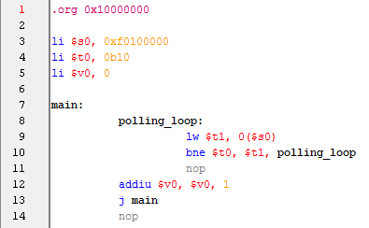
Polling an I/O Device
Project 1 used polling to read the switches
Example uses polling to increment counter while switch is pressed

Slide 5
UART
Universal Asynchronous Transmitter/Receiver
Used for serial communication
One bit at a time in each direction
Other common serial interfaces include:
SPI
I²C
RS-232
SATA
USB

Slide 6
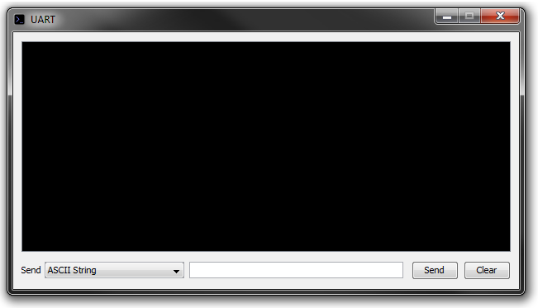
Interface
PLPTool UART
PLP UART
0xF0000000: Command Register
------------------------------00
0xF0000004: Status Register
------------------------------00
0xF0000008: Receive Buffer
------------------------01001000
0xF000000C: Send Buffer
------------------------01001000

Slide 7
UART Registers
Command Register
Address: 0xF0000000
Write only
Bit 0: Send
Transmits byte currently in send buffer
Bit 1: Clear Status
Puts next byte into receive buffer
Clears status register ready bit if there are no more characters

Slide 8
UART Registers
Status Register
Address: 0xF0000004
Read only
Bit 0: CTS (Clear To Send)
If 1, UART is ready to transmit a byte
Bit 1: Ready Bit
If 1, a byte is in the receive buffer that hasn’t been used

Slide 9
UART Buffers
Receive Buffer
Address: 0xF0000008
Contains byte received by UART
Send Buffer
Address: 0xF000000C
Location where byte to be transmitted is stored

Slide 10
Typical Send Procedure
Wait for clear to send bit in status register to be 1
0xF0000004: Status Register
------------------------------10
Clear to Send bit

Slide 11
Typical Send Procedure
Wait for clear to send bit in status register to be 1
Store byte to be sent in send buffer
0xF000000C: Send Buffer
------------------------01001000

Slide 12
Typical Send Procedure
Wait for clear to send bit in status register to be 1
Store byte to be sent in send buffer
Write a 1 to the send bit in the command register
0xF0000000: Command Register
------------------------------01
Send bit

Slide 13
Typical Receive Procedure
Wait for ready bit in status register to be 1
0xF0000004: Status Register
------------------------------10
Ready bit

Slide 14
Typical Receive Procedure
Wait for ready bit in status register to be 1
Read byte in receive buffer
0xF0000008: Receive Buffer
------------------------01001000

Slide 15
Typical Receive Procedure
Wait for ready bit in status register to be 1
Read byte in receive buffer
Write a 1 to the clear status bit in the command register
0xF0000000: Command Register
------------------------------10
Clear Status bit

Slide 16
Bit Masking
How do you access a single bit at a 32-bit register?
Bit masking takes advantage of AND operation
Only the bits set in your mask are the ones that will be kept

Slide 17
Bit Masking
Example: Find out if the third bit in a register $t0 set (place answer in $t2)
Create a mask
li $t1, 0b100
AND value register with mask
and $t2, $t0, $t1

Slide 18
Writing to Memory
Store word instruction
Same format as load word (lw)
sw $t0, 0($t1)
$t0 is now the value being written to the calculated memory address

Slide 19
Memory Access Offset
li $s0, 0xF0000000
Address | Contents
0xF0000000 | 0x00000000
0xF0000004 | 0x00000000
0xF0000008 | 0x00000000
0xF000000C | 0x00000000
$s0

Slide 20
Memory Access Offset
li $s0, 0xF0000000
lw $t1, 4($s0) #UART Status Register
Address | Contents
0xF0000000 | 0x00000000
0xF0000004 | 0x00000001
0xF0000008 | 0x00000000
0xF000000C | 0x00000000
$s0
Copied
$t1

Slide 21
PLP Microarchitecture

